Slide 1
Cloud computing

Slide 2
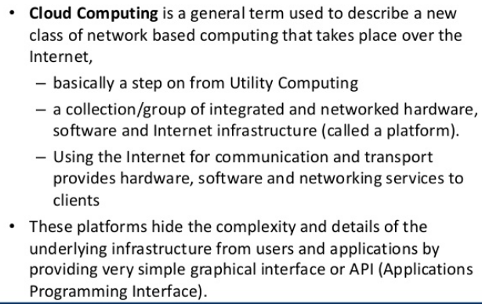
What is cloud Computing?

Slide 3
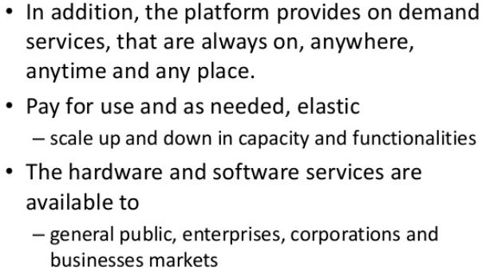
What is cloud Computing?

Slide 4
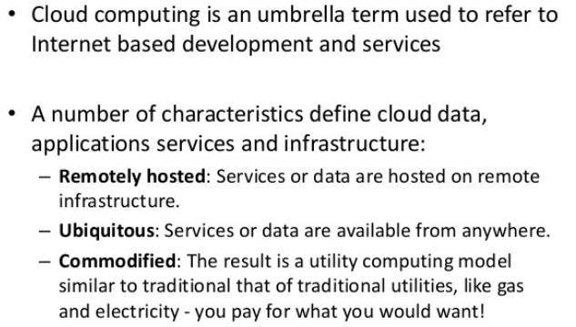
In short

Slide 5
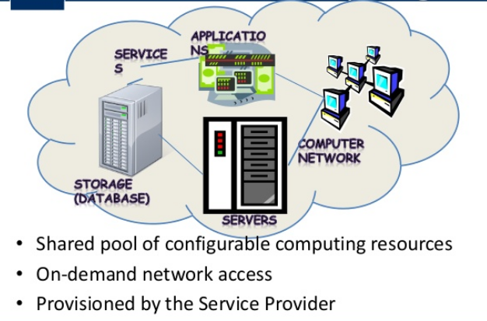
What is cloud computing?

Slide 6
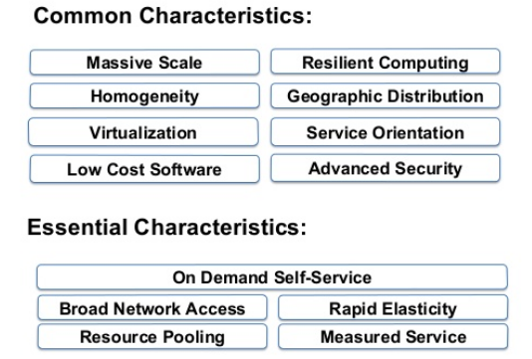
Characteristics:

Slide 7
Features
It's virtual
It can be secure
It's flexible and scalable
It can be affordable
It can be secure and affordable

Slide 8
Cloud Computing
Deployment
public
Private
Service
IaaS (Infrastructure As A Service)
Hybrid
PaaS (Platform as a Service)
SaaS (Software as a Service)
Community

Slide 10
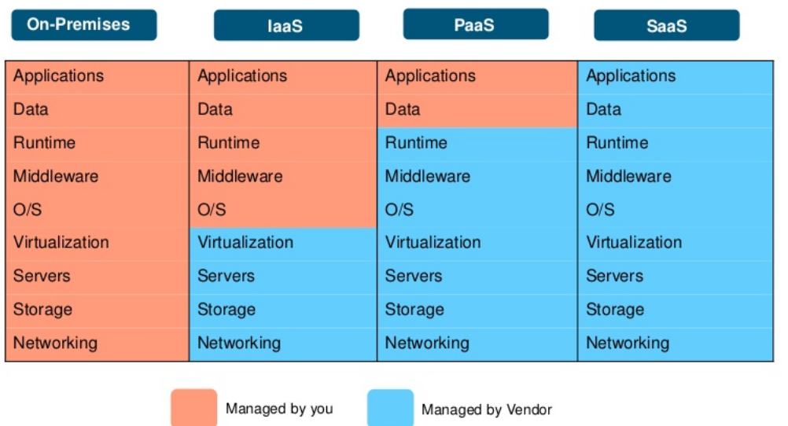

Slide 12
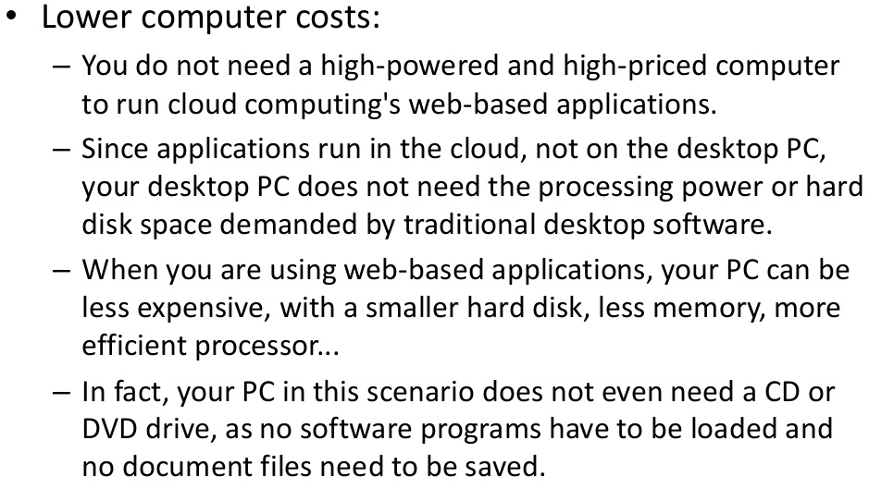
Advantages of cloud based services are

Slide 13
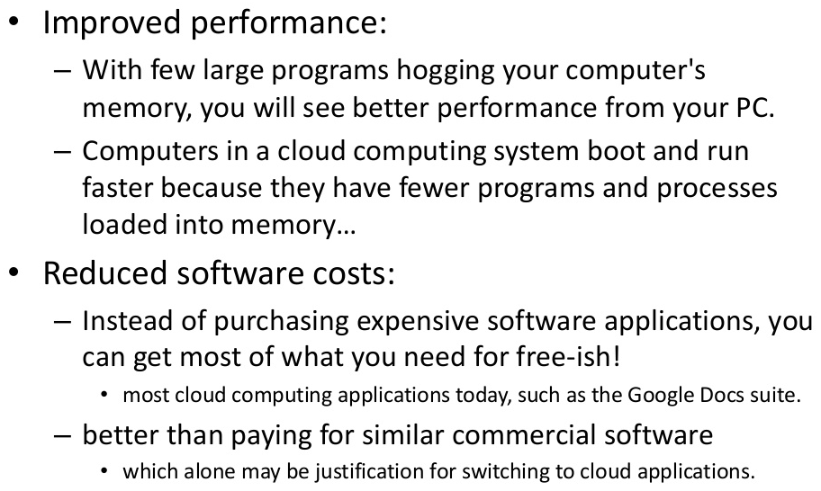
Advantages

Slide 14
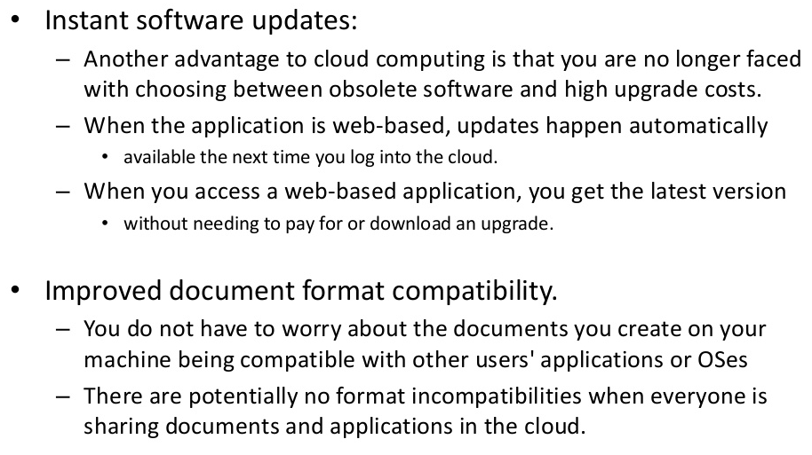
Advantages

Slide 15
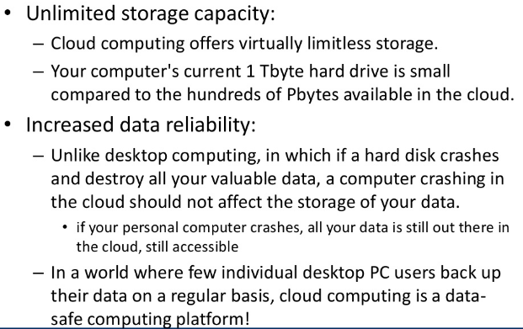
Advantages

Slide 16
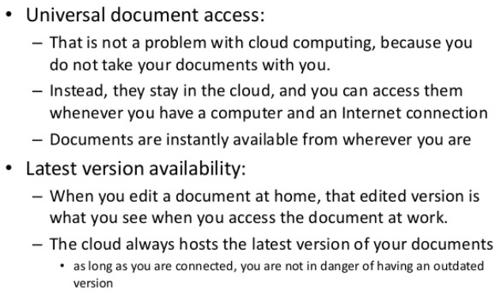
Advantages

Slide 17
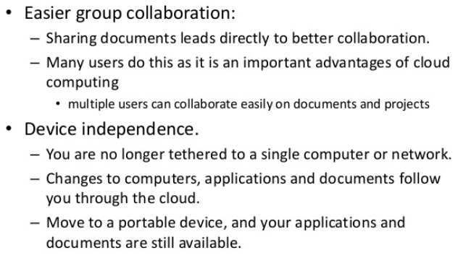
Advantages

Slide 18
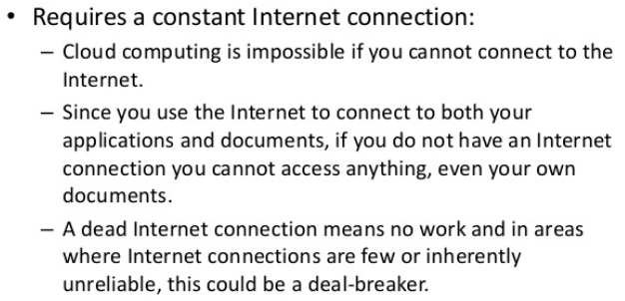
Disadvantages of Cloud Computing services

Slide 19
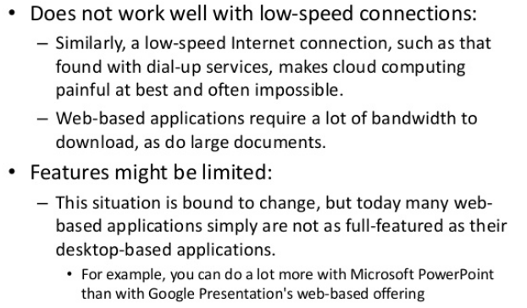
Disadvantages

Slide 20
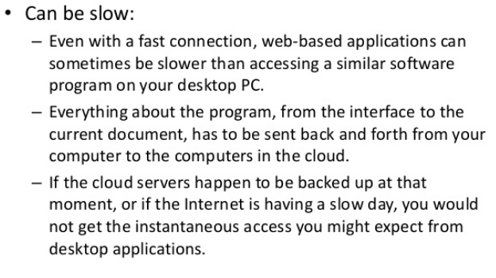
Disadvantages

Slide 21
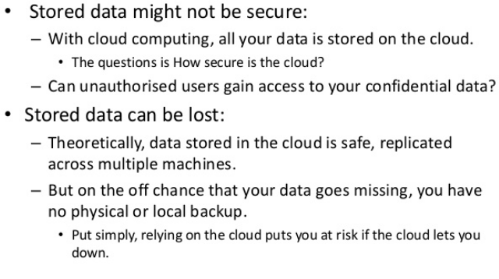
Disadvantages

Slide 22
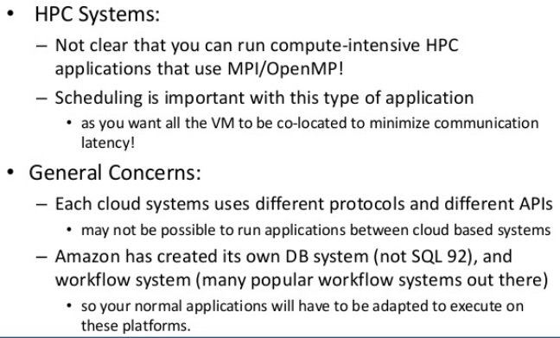
Disadvantages

Slide 23
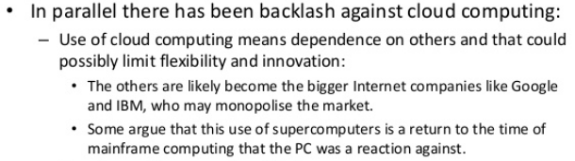
Challenges and opportunities

Slide 24
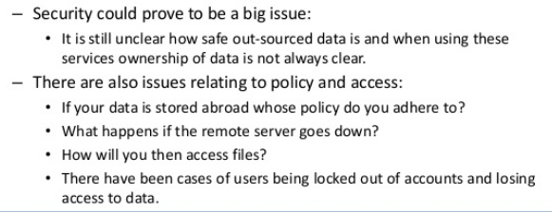
Challenges and opportunities

Slide 25
Components of Cloud Computing
The Client- The End User:
Client systems has some application installed which enables them to connect to cloud software or some infrastructure.
The Service (Functions in Cloud Computing):
Cloud computing is all about processes and the services launched through cloud computing always has to deal with processes with an expected output.
The Application
Application is the core of what users are going to use.

Slide 26
Components of Cloud Computing
The Platform
The platform is where all the applications and services are based upon
The Storage
The last and most critical components in cloud computing is the storage

